Slide 1

DEE 4544 DIGITAL ELECTRONICS Chapter 9: Logic Families
By : Dr. Noraisyah Tajudin
Email: noraisyahtajudin@lincoln.edu.my
Faculty of Engineering
Lincoln University College (LUC)
LECTURE 9
DATE : MAY 2024

Slide 2
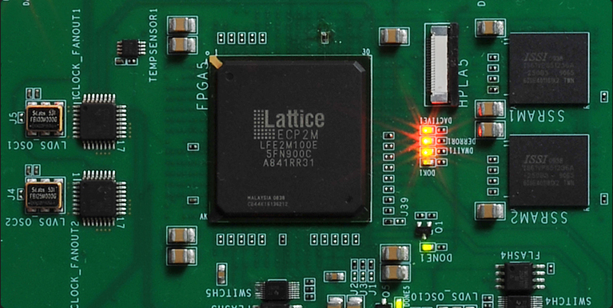
Programmable Logic Device (PLD)
A Programmable Logic Device (PLD) is an integrated circuit that contains an array of AND gates and another array of OR gates, allowing users to program these devices electrically to implement Boolean functions based on specific requirements.
These devices are programmed to perform custom functions using logic gates and programming, making them versatile and adaptable to various applications.
PLDs are distinct from fixed logic devices as they can be re-programmed using software to modify their functionality, unlike fixed logic devices that are permanently set up for a specific task

Slide 3
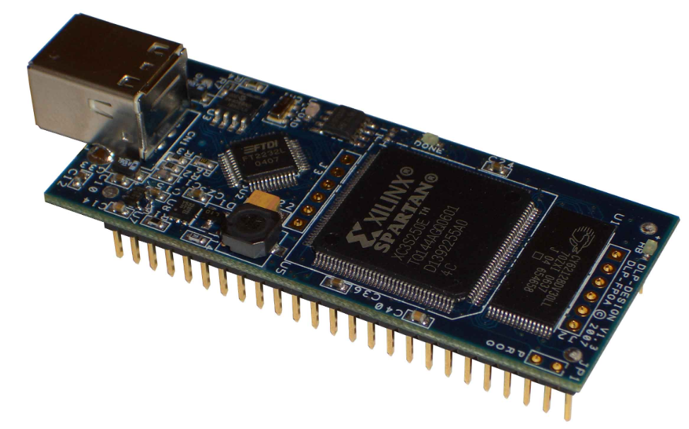
PLDs consist of essential components like logic cells or macrocells, programmable interconnects, input/output blocks (IOBs), fixed function blocks (optional), configuration memory, clock distribution network, and a JTAG interface for programming and testing.
The configuration of a CPLD, a type of PLD, is typically generated using high-level hardware description language (HDL) code or graphical design tools and then loaded into the device to enable it to perform specific logic functions.

Slide 4
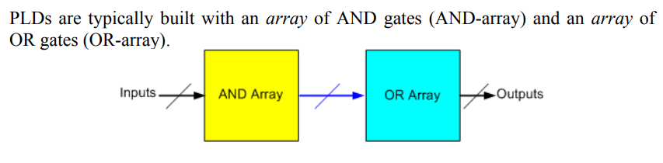

Slide 5
Array logic
A typical programmable logic device may have hundreds to millions of gates interconnected through hundreds to thousands of internal paths.
In order to show the internal logic diagram in a concise form, it is necessary to employ a special gate symbology applicable to array logic.

Slide 6
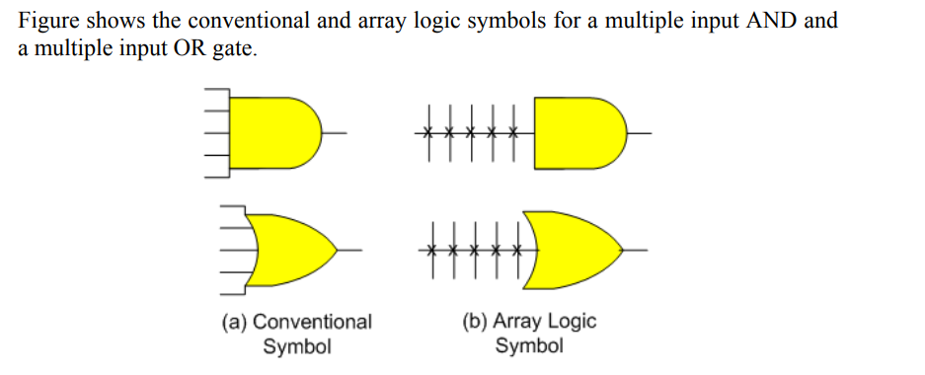

Slide 7
Types
Programmable Read Only Memory (PROM)
Programmable Array Logic (PAL)
Programmable Logic Array (PLA)

Slide 8
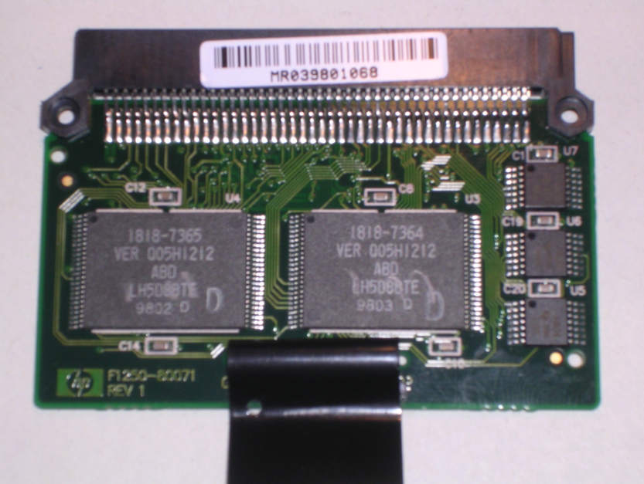
Programmable Read Only Memory (PROM)
Programmable Read Only Memory (PROM) is a type of read-only memory that allows data to be written to it once, making it a non-volatile memory that retains its data even when the power is turned off.
PROM technology has been somewhat replaced by newer technologies like Electrically Erasable Programmable ROM (EEPROM) and flash memory, which offer more flexibility in terms of erasing and reprogramming data.

Slide 9
While PROM can be more cost-effective for certain applications due to its one-time programming feature, it is considered somewhat outdated compared to more modern memory technologies.
Despite its decreasing prevalence in contemporary devices, PROM is still used in specific applications where one-time programming suffices, such as storing firmware or boot programs in electronic devices.

Slide 10
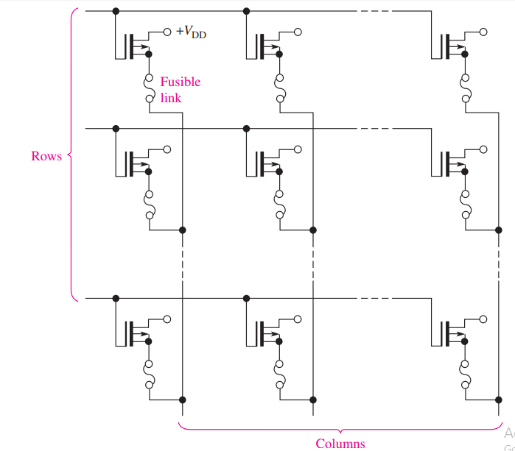
MOS PROM array with fusible links.

Slide 11
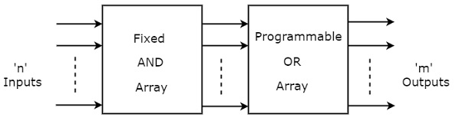
PROM is a programmable logic device that has fixed AND array & Programmable OR array.
The block diagram of PROM is shown in the following figure.

Slide 12
Here, the inputs of AND gates are not of programmable type. So, we have to generate 2^{n} product terms by using 2^{n} AND gates having n inputs each. We can implement these product terms by using nx2^{n} decoder. So, this decoder generates ‘n’ min terms.
Here, the inputs of OR gates are programmable. That means, we can program any number of required product terms, since all the outputs of AND gates are applied as inputs to each OR gate. Therefore, the outputs of PROM will be in the form of sum of min terms.

Slide 13

Example
Let us implement the following Boolean functions using PROM
The given two functions are in sum of min terms form and each function is having three variables X, Y & Z. So, we require a 3 to 8 decoder and two programmable OR gates for producing these two functions.

Slide 14
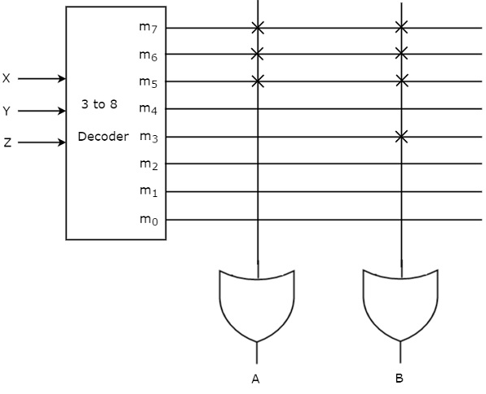

Slide 15
Here, 3 to 8 decoder generates eight min terms. The two programmable OR gates have the access of all these min terms.
But, only the required min terms are programmed in order to produce the respective Boolean functions by each OR gate.
The symbol ‘X’ is used for programmable connections.

Slide 16
EPROM
An EPROM is an erasable PROM.
Unlike an ordinary PROM, an EPROM can be reprogrammed if an existing program in the memory array is erased first.

Slide 17
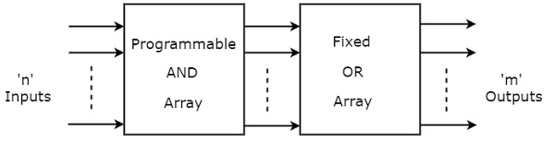
Programmable Array Logic (PAL)
PAL is a programmable logic device that has Programmable AND array & fixed OR array.
The advantage of PAL is that we can generate only the required product terms of Boolean function instead of generating all the min terms by using programmable AND gates.
The block diagram of PAL is shown in the following figure.

Slide 18
Here, the inputs of AND gates are programmable. That means each AND gate has both normal and complemented inputs of variables. So, based on the requirement, we can program any of those inputs. So, we can generate only the required product terms by using these AND gates.
Here, the inputs of OR gates are not of programmable type. So, the number of inputs to each OR gate will be of fixed type. Hence, apply those required product terms to each OR gate as inputs. Therefore, the outputs of PAL will be in the form of sum of products form.

Slide 19



Example
Let us implement the following Boolean functions using PAL
The given two functions are in sum of products form. There are two product terms present in each Boolean function. So, we require four programmable AND gates & two fixed OR gates for producing those two functions.

Slide 20
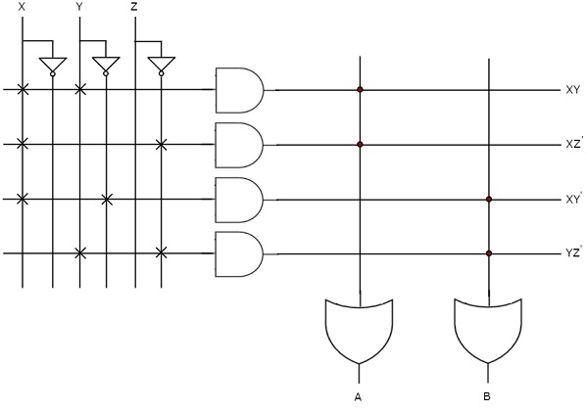

Slide 21
The programmable AND gates have the access of both normal and complemented inputs of variables.
So, program only the required literals in order to generate one product term by each AND gate. The symbol ‘X’ is used for programmable connections.
Here, the inputs of OR gates are of fixed type. So, the necessary product terms are connected to inputs of each OR gate. So that the OR gates produce the respective Boolean functions. The symbol ‘.’ is used for fixed connections.

Slide 22
The programmable AND gates have the access of both normal and complemented inputs of variables. So, program only the required literals in order to generate one product term by each AND gate.
All these product terms are available at the inputs of each programmable OR gate. But, only program the required product terms in order to produce the respective Boolean functions by each OR gate. The symbol ‘X’ is used for programmable connections.

Slide 23
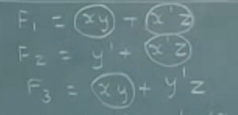
Implement using PAL & PLA

Slide 24
Thank You

